Slide 1

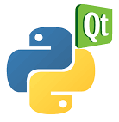
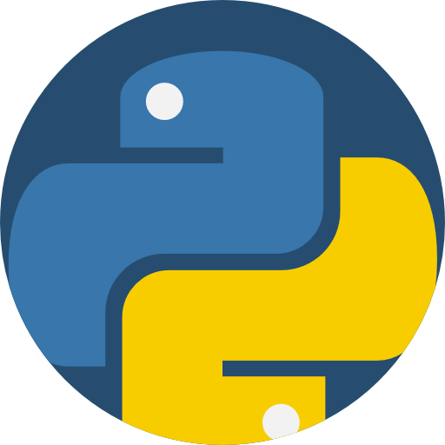
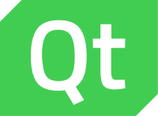
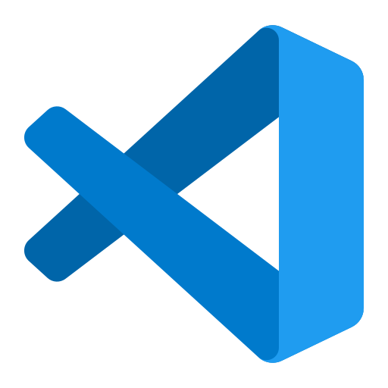
PlotJugglerWithPython 아키텍처 설계서
Documentation
MarkDown
Source Code
Management
Github
Base
Plot
Framework
3rd Party
pyqtgraph
Pyqt5
os, sys, numpy, pandas
Language : Python 3.11.1
Development Enviroment
Qt Designer
Visual Studio Code

